Slide 1

Types of
MachineLearning

Slide 2
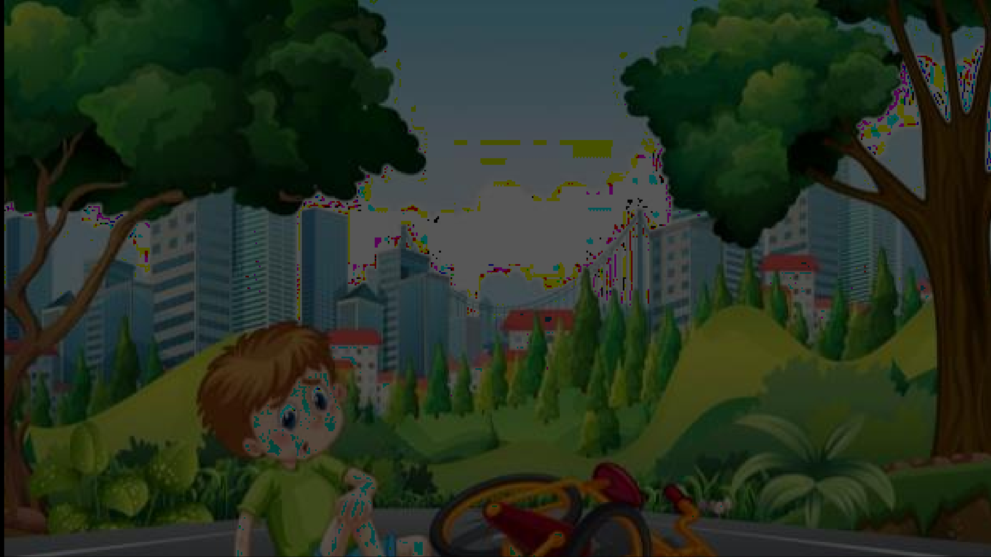









Approaches for Learning
•

Slide 3
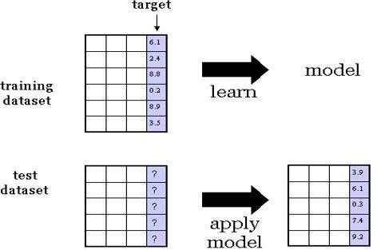
Supervised Learning from Data
Predicting continuous target variable

Slide 4

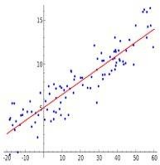
Task : Regression
Example : Stock Price Prediction
Only one target variable ?
How to take a combination of the features (linear regression)?
Anything more general than that?
Is local minimum error the global minimum error ?

Slide 5
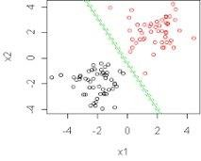
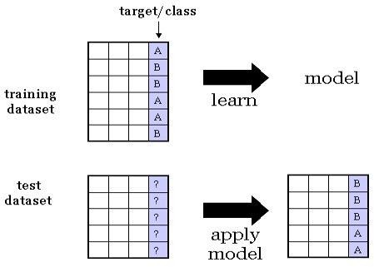
Task : Classification
Example : Classify whether the patient is suffering from cancer or not.

Slide 6
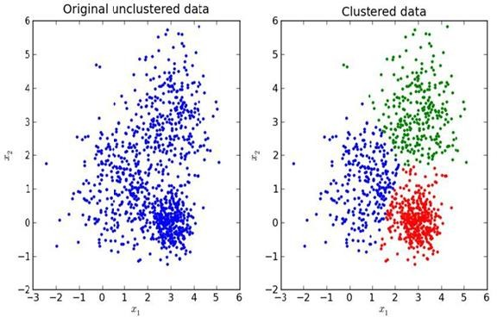
Unsupervised Learning
Task : Clustering
No Target variable

Slide 7
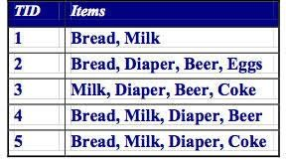
Task : Association mining
{milk} → {bread}
{milk, cheese, eggs} → {bread}
{milk, diaper} → {beer}

Slide 8
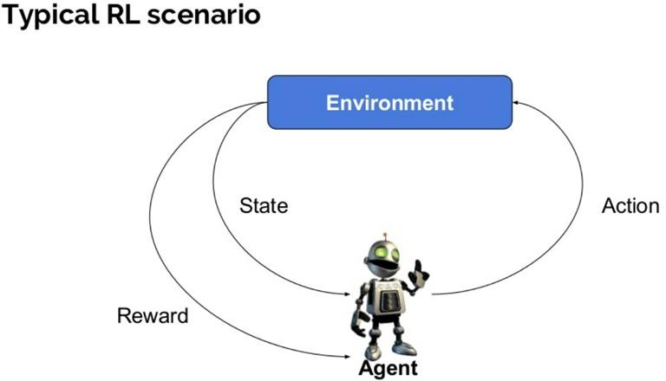
Reinforcement Learning
Learn from interaction with the environment
Transition from one state to another
Rewards/punishments from sequence of actions
Game Playing Robotics
Image Source : https://www.guru99.com/reinforcement-learning-tutorial.html

Slide 9
Applications
Manufacturing
Pick a device and put it in right container
Self-driving cars
Detect obstacles, proper routing, traffic signal
Power systems
Network routing

Slide 10
References
https://chatbotsmagazine.com/reinforcement-learning-and-its- practical-applications-8499e60cf751
https://www.guru99.com/reinforcement-learning-tutorial.html
https://cs.gmu.edu/~jessica/DimReducDanger.html
https://elearningindustry.com/machine-learning-process-and- scenarios

